Slide 1

MASTER
CLASS
The Art of
Interactions
May Sj Soriano
Notes:
This presentation will support you while facilitating L1 Hello Points workshop online to your clients.
It’s divided into 3 parts. Each one has opening, pause, process and closure.
You will find here only with the content (white) slides that you can present during each session.
[If you put music before the meeting start, choose music with lyrics and nice rhythm, so it won’t be like Pause music Start exactly on time]
If you have the Explorer badge, you can put it on your shirt so the participants will see it on you during the session.
Hello and thank you for joining this Academy How to session.

Slide 2


Opening
P
A
U
S
E
Notes:
Any questions up to now?

Slide 3
Welcome!
Recall an unforgettable interaction you have experienced in the past
Describe the experience in 3 words
SHARE IN BREAKOUT ROOM
Notes:
Welcome everyone to the online session
My name is [introduce yourself 2–3 sentences]
Together with me is [name of helper] from…..,
We will be managing this call together ☺

Slide 4
What is Interaction?
It is the ART & SKILL of how a person is being processed to address his agenda or intentions.
DICTIONARY DEFINITION:
Interaction is communication or direct involvement with someone or something
Notes:
Welcome everyone to the online session
My name is [introduce yourself 2–3 sentences]
Together with me is [name of helper] from…..,
We will be managing this call together ☺

Slide 5
What is Interaction?
It is the ART & SKILL of how a person is being processed to address his agenda or intentions.
DICTIONARY DEFINITION:
Interaction is communication or direct involvement with someone or something
Notes:
Welcome everyone to the online session
My name is [introduce yourself 2–3 sentences]
Together with me is [name of helper] from…..,
We will be managing this call together ☺

Slide 6
Essential Skills of Coaching
Building Trust
Asking Powerful Questions
Intuiting
Listening
Articulating What is Going On
Mining Values
Bottomlining
Self-Management
Notes:
This is what people will learn during the workshop
[Read slide]

Slide 7
Partner Up!
Let us see how we listen...
You will be assigned to a breakout room with a partner.
Please choose who will be Partner A and Partner B
Notes:
This is what people will learn during the workshop
[Read slide]

Slide 8
Round 1
Who are BEAUTIFUL ones in the group?
Who are the INTELLIGENT ones?
Please tell everyone why you are the BEAUTIFUL / GORGEOUS one
--all speak at the same time
Notes:
This is what people will learn during the workshop
[Read slide]

Slide 9
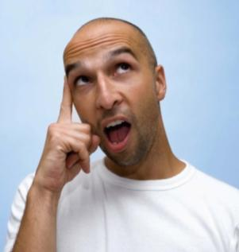
Levels of Listening
Level 1
INTERNAL
Notes:
This is what people will learn during the workshop
[Read slide]

Slide 10
Round 2
Partner A, recall an UNFORGETTABLE HAPPY EXPERIENCE
Partner B, recall an UNFORGETTABLE CHALLENGING EXPERIENCE
Partner A will start sharing their story.
When you see SWITCH through the breakout room message, Partner B will then share their story.
And then, when you see SWITCH again, Partner A continues their story; and so on and so forth whenever we SWITCH.
Notes:
This is what people will learn during the workshop
[Read slide]

Slide 11
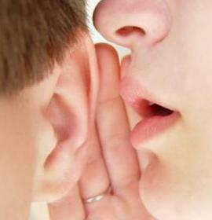
Levels of Listening
Level 1
Level 2
INTERNAL
FOCUSED
Notes:
This is what people will learn during the workshop
[Read slide]

Slide 12


Round 3
Get a FAVORITE CARD from The Coaching Game.
What inspires you? What motivates you?
Each partner will have 2 minutes.
Pure listening, no asking questions, no advice, no interruptions
Please pin the video of the partner speaking.
We will be back to the main room after this sharing.
Notes:
This is what people will learn during the workshop
[Read slide]

Slide 13
Breakout! Let us mine values
Partner A tell Partner B and vice versa, 2.5 mins. each partner; total 5 mins. Do not affirm nor contradict what you hear.
What emotions did you feel coming from your partner’s story?
Who is your partner behind the story?
What learning and/or inspiration did you get from your partner’s story?
Notes:
This is what people will learn during the workshop
[Read slide]

Slide 14
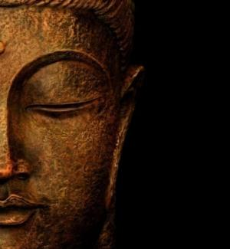
Levels of Listening
Level 1
Level 2
Level 3
INTERNAL
FOCUSED
GLOBAL/
SENSITIVE
Notes:
This is what people will learn during the workshop
[Read slide]

Slide 15





KNOWING
RESULTS
REASONS
BEING
DOING
Notes:
This is what people will learn during the workshop
[Read slide]

Slide 16
Everyone is naturally born
intelligent, loving, powerful and beautiful!
Every human being is good!
The agenda comes from the participant!
INTERACTION/COACHING
Interaction
is a Partnership!
PRINCIPLES
Interaction addresses the participant’s Whole Life!
Notes:
This is what people will learn during the workshop
[Read slide]

Slide 17
KNOWLEDGE
SKILLS
STRUCTURES
INNER RESEARCH
BUILD ON THE FOUNDATION
Notes:
This is what people will learn during the workshop
[Read slide]

Slide 18




THANK
YOU!
HAPPY
INTERACTION!
coachmaycares@gmail.com
+63 917 846 3405
Notes:
This is what people will learn during the workshop
[Read slide]

